Slide 1
NBA lottery prediction
Team 6
鄭幃謙 顏訓哲 林湛悅
林晁璿 黃允暘 杜方辰

Slide 2
TABLE OF CONTENTS
01
03
02
04
Motivation
Classifier
Data
Pre-Process
Result &
Conclusion

Slide 3
01
Motivation

Slide 4
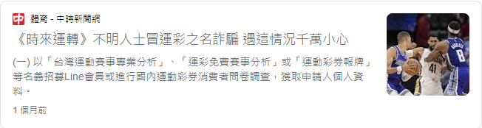

Slide 5
02
Data Pre-Process

Slide 6
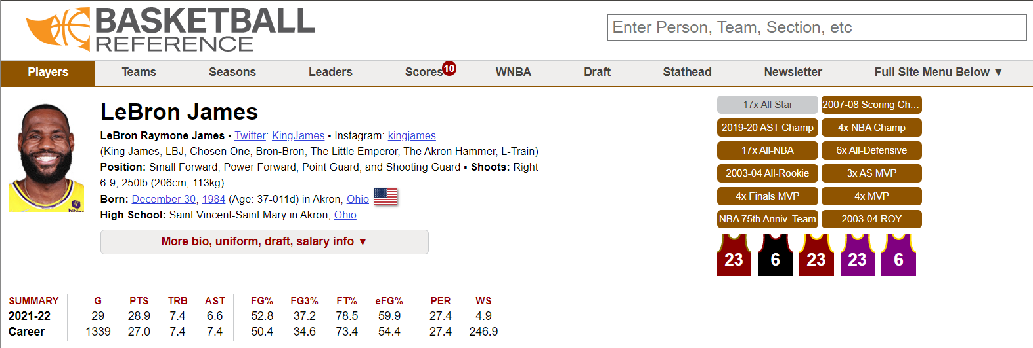
dataset
From https://www.basketball-reference.com
Every active players (469 players from 30 teams)
Every game data in last five years (since 16-17 season)

Slide 7
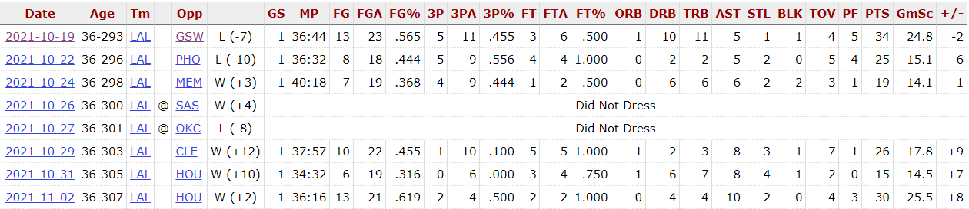
Player’s Data Attributes
Including age, GS, MP, FG…, etc.

Slide 8
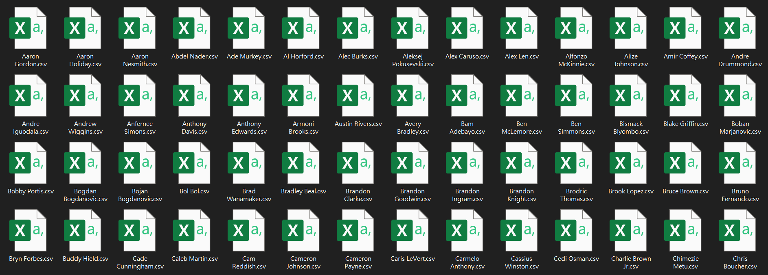
Fetch Player’s Data
Scraping (referencing https://github.com/vishaalagartha/basketball_reference_scraper)

Slide 9
Game’s data attribute
Date
2 team’s name
➔ Team A
➔ Team B
Winner of game
Player for each match
➔ A1 ~ A20
➔ B1 ~ B20

Slide 10
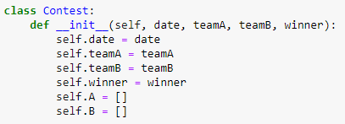
Collect Game Data
Concatenate all player’s data into temp.csv
Create a class named “Contest”, and a list named “Game”
For each player, traverse all games he played for
If the game is already in “Game”
➔ append the player list of that “Contest” item
else
➔ append a new “Contest” item into “Game” list

Slide 11
Build X Y
One game is one data
According to the players list in a game, find the player’s data
According to the game time, grab previous 3 games for a player, respectively
X.shape=(num_of_game, 20*3*attribute_num)
Y is Every game’s result

Slide 12
03
Classifier

Slide 13
model
SVM
Gradient Boosting
XGBoost
RandomForest

Slide 14
04
Result & Conclusion

Slide 15
result
SVC :0.586
Gradient Boosting :0.584
XGBoost:0.579
RandomForest:0.605

Slide 20
WHAT SETS US APART?
MERCURY
Mercury is the closest planet to the Sun and the smallest one
NEPTUNE
Neptune is the farthest planet from the Sun and the fourth-largest
MARS
Despite being red, Mars is actually a cold place. It's full of iron oxide dust

Slide 21
INTRODUCTION
ABOUT US
Here you give a brief intro of the topic you want to talk about. For example, you can talk about Mercury
You can give a brief intro of the topic you want to talk about here. For example, if you talk about Mercury, you can say that it’s the smallest planet

Slide 22
OUR TEACHING METHOD
ACTIVITIES
FEEDBACK
Jupiter is a gas giant and the biggest planet
Saturn is a gas giant and has several rings
GOALS
EVALUATION
Earth is the planet where we all live on
Pluto is now considered a dwarf planet

Slide 23
THE CURRICULUM
JUPITER
Jupiter is the biggest
planet and the fourth-brightest one
NEPTUNE
MARS
Neptune is the farthest planet from the Sun and the fourth-largest one
Despite being red, Mars is a cold place full of iron oxide dust

Slide 24
THE SLIDE TITLE GOES HERE!
Do you know what helps you make your point clear?
Lists like this one:
They’re simple
You can organize your ideas clearly
You’ll never forget to buy milk!
And the most important thing: the audience won’t miss the point of your presentation.

Slide 25
OUR ACADEMIC AREAS
MERCURY
VENUS
MARS
It’s the closest planet to the Sun
Venus is the second planet from the Sun
Mars is actually a very cold place
JUPITER
SATURN
NEPTUNE
Jupiter is the biggest planet of them all
It’s composed of hydrogen and helium
It’s the farthest planet from the Sun

Slide 26
OUR MISSION & VISION
MISSION
VISION
Mercury is the closest planet to the Sun and the smallest one
Venus has a beautiful name and is the second planet from the Sun

Slide 27
OUR VALUES
LOYALTY
EFFICIENCY
Venus is the second planet from the Sun and it’s beautiful
Jupiter is a gas giant and the biggest planet in the Solar System
RELIABILITY
COMMITMENT
Mars is actually a cold place. It's full of iron oxide dust
Saturn is composed mostly of hydrogen and helium

Slide 28
OUR SUCCESS
9/10
95%
2,500
Saturn is the ringed planet
Neptune is the farthest
planet from the Sun and the fourth-largest
Venus has a beautiful name

Slide 29
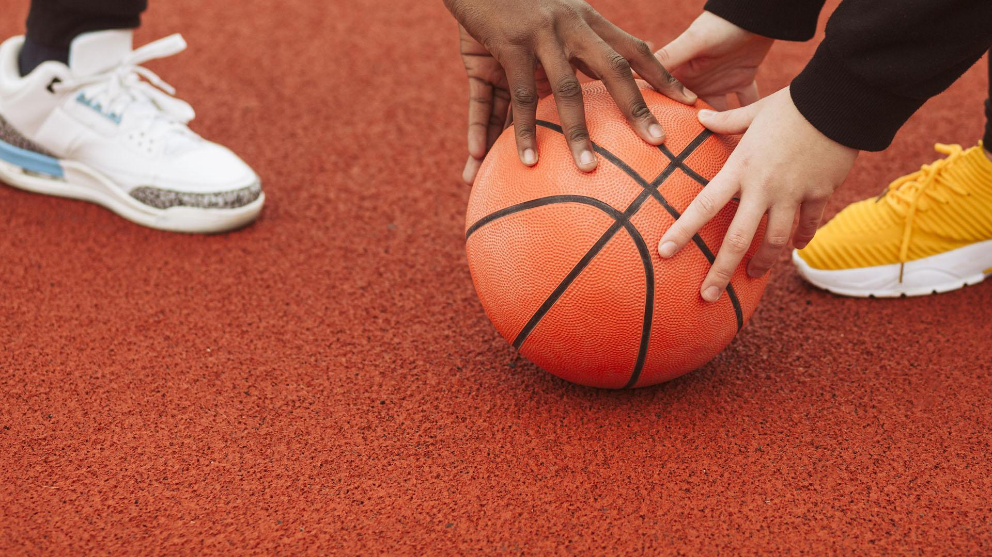
A PICTURE IS WORTH A THOUSAND WORDS

Slide 30
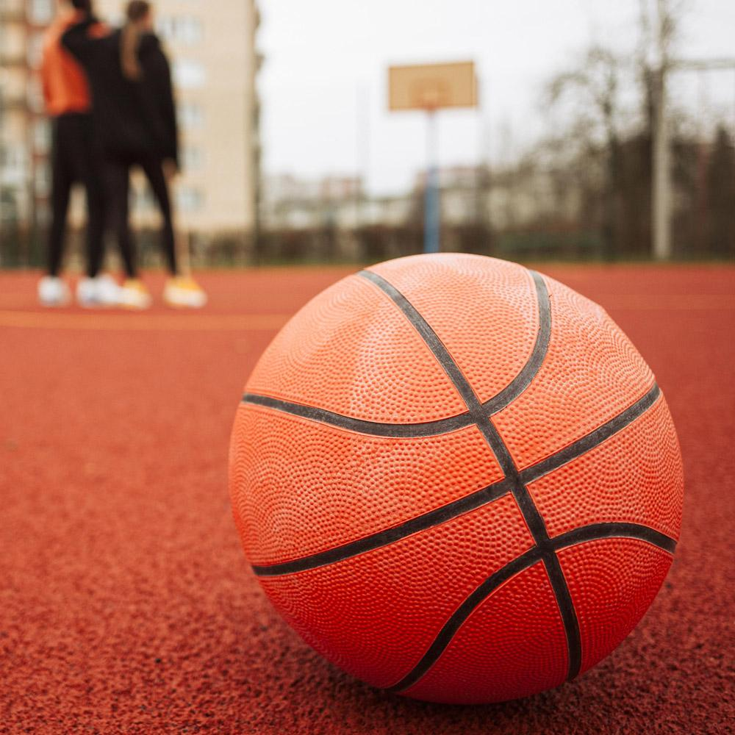
A PICTURE ALWAYS REINFORCES THE CONCEPT
Images reveal large amounts of data, so remember: use an image instead of a long text. Your audience will appreciate it

Slide 31
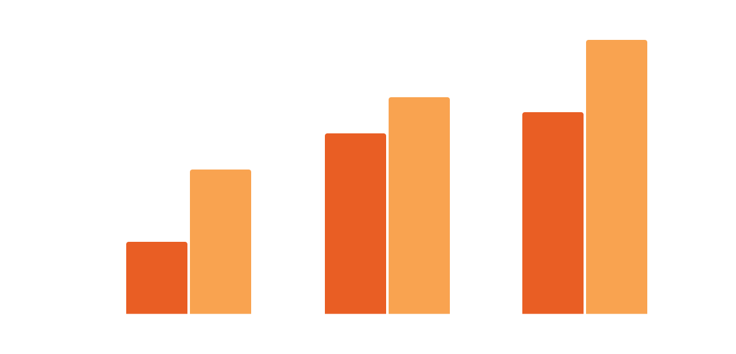
OUR ENROLLMENT STATISTICS
UNDER 12’S
Mercury is the closest planet to the Sun
UNDER 20’S
Venus is the second planet from the Sun
Follow the link in the graph to modify its data and then paste the new one here. For more info, click here

Slide 32
OUR CENTERS
EUROPE
Mercury is the closest planet to the Sun
AUSTRALIA
Venus is the second planet from the Sun

Slide 33
AWESOME WORDS

Slide 34
CENTER SCHEDULE
DAY | ACTIVITY | ROOM
MONDAY | Mercury is the closest planet to the Sun | 01
TUESDAY | Venus is the second planet from the Sun | 04
WEDNESDAY | Despite being red, Mars is a cold place | 03
TUESDAY | Jupiter is the biggest planet in the Solar System | 02
FRIDAY | Saturn is composed of hydrogen and helium | 05

Slide 35
STUDENT PROGRESS
Venus has a beautiful name
Mercury is the smallest planet
2nd TERM
4th TERM
1st TERM
3rd TERM
Jupiter is the biggest planet
Mars is actually a cold place

Slide 36
150,000
BIG NUMBERS CATCH YOUR AUDIENCE’S ATTENTION

Slide 37
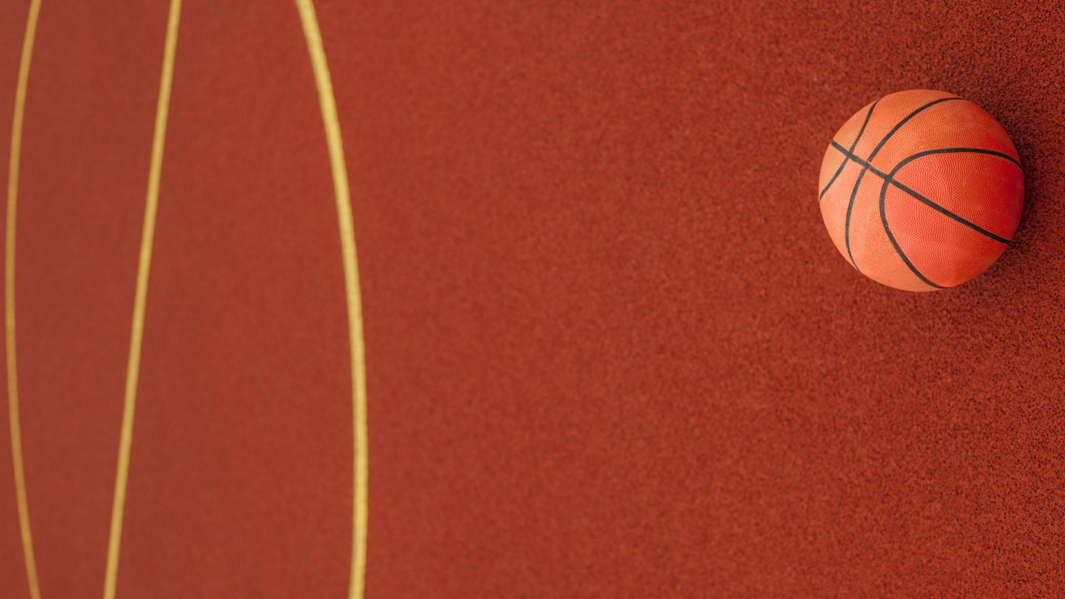
SNEAK PEEK
You can replace the image on the screen with your own work. Just right-click on it and select “Replace image”

Slide 38
OUR STAFF
HEAD DIRECTOR
HEAD COACH
TEAM TRAINER
SKILLS COACH
NUTRITION COACH
Jupiter is the biggest planet of them all
Despite being red, Mars is a cold planet
Venus is the second planet from the Sun

Slide 39

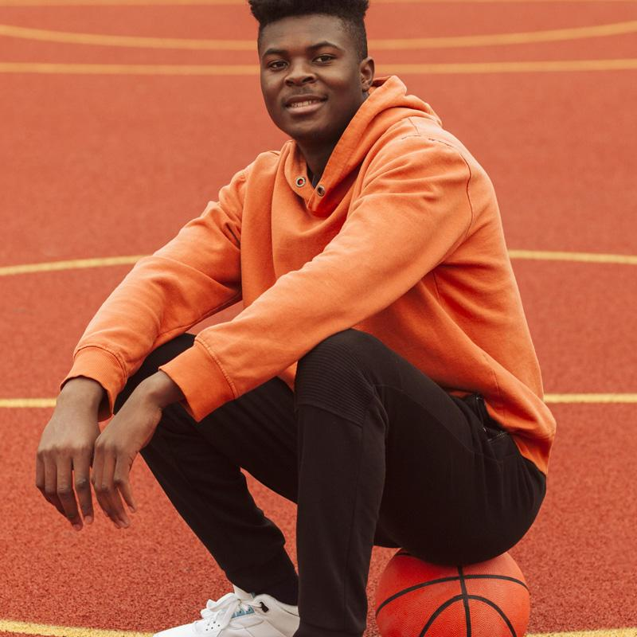
OUR BEST COACHES
JENNA DOE
TIMMY JIMMY
Here you can talk a bit about this person
Here you can talk a bit about this person

Slide 40
OUR GOALS
MERCURY
VENUS
MARS
It’s the closest planet to the Sun and the smallest in the Solar System
Venus has a beautiful name and is the second planet from the Sun
Despite being red, Mars is actually a cold place. It’s full of iron oxide dust

Slide 41
ENROLLMENT PROCESS
1
2
3
4
DOWNLOAD THE FORM
SEND THE FORM
SEND ALL THE DOCS
FINAL PAYMENT
Jupiter is a gas giant and the biggest planet
Saturn is a gas giant and has several rings
Neptune is the farthest planet from the Sun
Earth is the third planet from the Sun. We live on it!

Slide 42
SPECIAL REMINDERS
VENUS
JUPITER
SATURN
Venus is terribly hot, and its atmosphere is extremely poisonous
Jupiter is a gas giant and the biggest planet in the Solar System
Saturn is a gas giant. It's composed mostly of hydrogen and helium
MARS
NEPTUNE
Mars is actually a very cold place. It's full of iron oxide dust
Neptune is the farthest planet from the Sun, and the fourth-largest

Slide 43
THANKS
DO YOU HAVE ANY QUESTIONS?
youremail@freepik.com
+91 620 421 838
yourcompany.com
Please keep this slide for attribution

Slide 44
SOLID BASKETBALL ICON PACK

Slide 45
ALTERNATIVE RESOURCES

Slide 46
ALTERNATIVE RESOURCES
Here’s an assortment of alternative resources whose style fits that of this template:
PHOTOS:
Teenager posing at the basketball field
Teenager posing at the basketball field 2
Teenager holding the basketball outdoors
Woman holding a basketball outdoors
Black american woman playing basketball close-up
Basketball on a field close-up
Close up of a basketball ball
Top view of basketball with copy space

Slide 47
RESOURCES
Did you like the resources on this template? Get them for free at our other websites:
VECTORS
PHOTOS:
Basketball icons collection
Basketball background in flat design
Basketball icons
Close up of a basketball ball
Teenagers at the basketball field
Smiley black american woman
Teenager posing
Close up of a basketball outdoors

Slide 48
Instructions for use
In order to use this template, you must credit Slidesgo by keeping the Thanks slide.
You are allowed to:
- Modify this template.
- Use it for both personal and commercial projects.
You are not allowed to:
- Sublicense, sell or rent any of Slidesgo Content (or a modified version of Slidesgo Content).
- Distribute Slidesgo Content unless it has been expressly authorized by Slidesgo.
- Include Slidesgo Content in an online or offline database or file.
- Offer Slidesgo templates (or modified versions of Slidesgo templates) for download.
- Acquire the copyright of Slidesgo Content.
For more information about editing slides, please read our FAQs or visit Slidesgo School:
https://slidesgo.com/faqs and https://slidesgo.com/slidesgo-school

Slide 49
Instructions for use (premium users)
In order to use this template, you must be a Premium user on Slidesgo.
You are allowed to:
Modify this template.
Use it for both personal and commercial purposes.
Hide or delete the “Thanks” slide and the mention to Slidesgo in the credits.
Share this template in an editable format with people who are not part of your team.
You are not allowed to:
Sublicense, sell or rent this Slidesgo Template (or a modified version of this Slidesgo Template).
Distribute this Slidesgo Template (or a modified version of this Slidesgo Template) or include it in a database or in any other product or service that offers downloadable images, icons or presentations that may be subject to distribution or resale.
Use any of the elements that are part of this Slidesgo Template in an isolated and separated way from this Template.
Register any of the elements that are part of this template as a trademark or logo, or register it as a work in an intellectual property registry or similar.
For more information about editing slides, please read our FAQs or visit Slidesgo School:
https://slidesgo.com/faqs and https://slidesgo.com/slidesgo-school

Slide 50
Fonts & colors used
This presentation has been made using the following fonts:
Alfa Slab One
(https://fonts.google.com/specimen/Alfa+Slab+One)
Roboto
(https://fonts.google.com/specimen/Roboto)
#242841
#ffffff
#e95e24
#f9a350
#777d99
#fcc600

Slide 51





Storyset
Create your Story with our illustrated concepts. Choose the style you like the most, edit its colors, pick the background and layers you want to show and bring them to life with the animator panel! It will boost your presentation. Check out How it Works.
Pana
Amico
Bro
Rafiki
Cuate

Slide 52
Use our editable graphic resources...
You can easily resize these resources without losing quality. To change the color, just ungroup the resource and click on the object you want to change. Then, click on the paint bucket and select the color you want. Group the resource again when you’re done. You can also look for more infographics on Slidesgo.

Slide 55
JANUARY
FEBRUARY
MARCH
APRIL
MAY
JUNE
PHASE 1
Task 1
Task 2
PHASE 2
Task 1
Task 2
JANUARY
FEBRUARY
MARCH
APRIL
PHASE 1
Task 1
Task 2

Slide 58
...and our sets of editable icons
You can resize these icons without losing quality.
You can change the stroke and fill color; just select the icon and click on the paint bucket/pen.
In Google Slides, you can also use Flaticon’s extension, allowing you to customize and add even more icons.

Slide 59
Educational Icons
Medical Icons

Slide 60
Business Icons
Teamwork Icons

Slide 61
Help & Support Icons
Avatar Icons

Slide 62
Creative Process Icons
Performing Arts Icons

Slide 63
Nature Icons

Slide 64
SEO & Marketing Icons

Slide 65


